Slide 1

Geospatial Chart Types

Slide 2
Encoding Geospatial Data
Color applied to enumeration units (e.g., countries, provinces, states, zipcodes, etc.)
Points or areas of varying size or color intensity
Lines of varying thickness or color intensity
Notes:
Talk through effective techniques for encoding data.
Enumeration unit – spatial unit defined for a particular puprose

Slide 3
Choropleth Maps
Notes:
When to use choropleths: when the enumeration unit actually matters

Slide 4
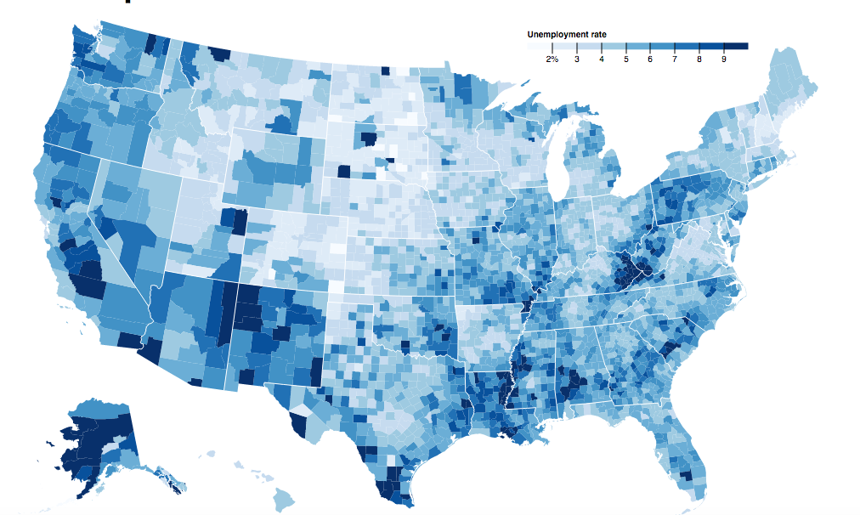
What: enumeration unit (e.g., state, province, etc.), aggregated quantitative data
Why: compare quantitative data by unit and region
How: saturation, brightness, hue
Challenges: sizing proportional to political / arbitrary boundaries, false sense of boundary change
Notes:
Enumeration unit in which data is aggregated over the unit. It often makes sense show the smallest enumeration unit.
Unemployment rate
Ddarker or more saturated is seen as greater.

Slide 5
https://bl.ocks.org/mbostock/4060606
Notes:
Unemployment rates as of 2016 using a threshold scale.

Slide 6
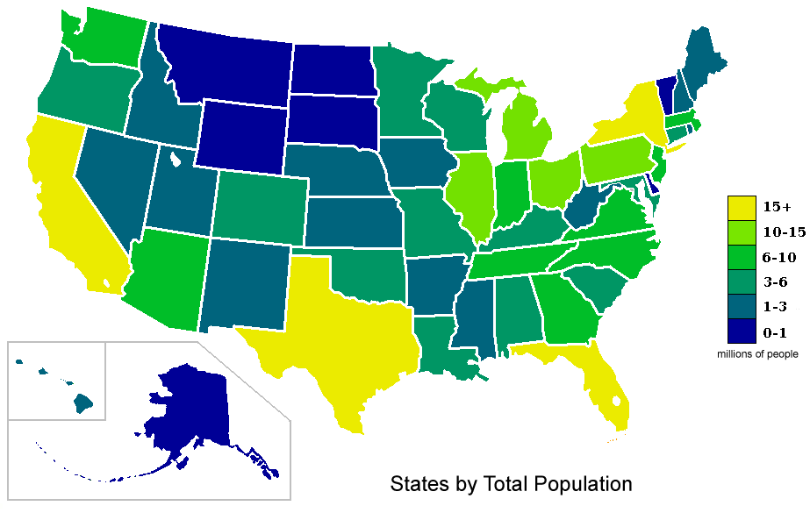
http://upload.wikimedia.org/wikipedia/commons/4/48/USA_states_population_map_2007_color.png
Notes:
Classed data in this case.

Slide 7
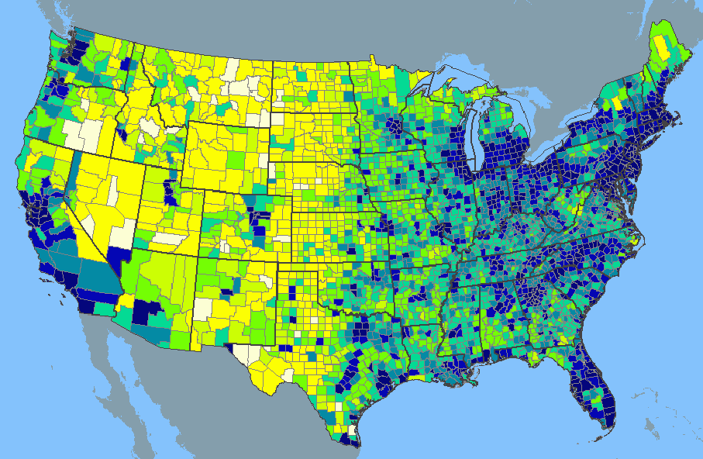
http://www.learnnc.org/lp/media/uploads/2010/02/usa-2000-population-density.gif

Slide 8
Dot Maps
Notes:
Also called dot density map or dot distribution map.

Slide 9
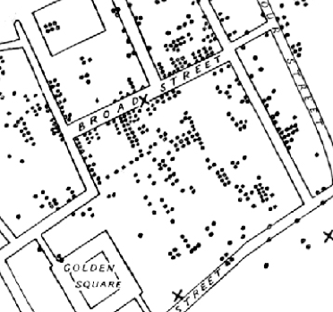
What: quantitative data, specific location
Why: show precise location, compare density
How: points
Challenges: exactness matters, needs an equal-area map projection, too much overlap
Notes:
Show precise locations of discrete data such as people, goods, phenomena; smoothness. In one to one dot maps the data is mapped to one dot, whereas in one to many there are more and care must be taken in conveying this to the viewer.

Slide 10
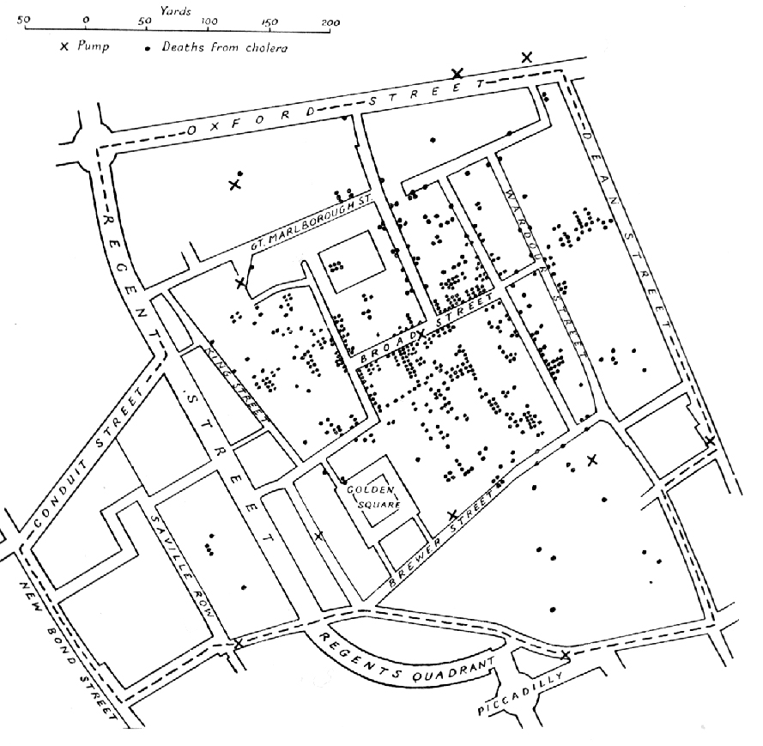
http://www.ph.ucla.edu/epi/snow/tufte_snow2.htm
Notes:
A dot map of Snow’s cholera deaths in London in 1854. Deaths marked by dots and water pumps by crosses.

Slide 11
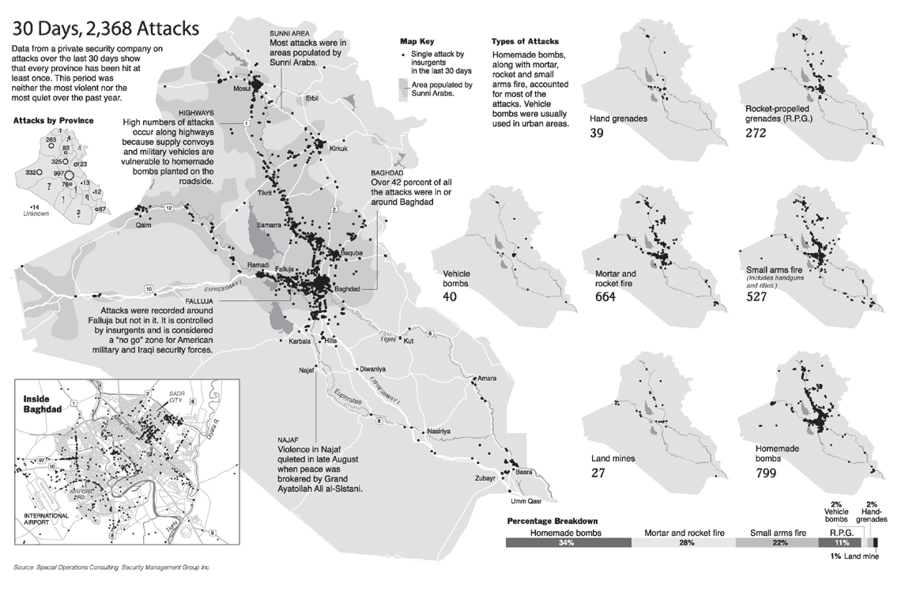
http://www.nytimes.com/imagepages/2004/09/28/international/29ATTACK-GRAPH.html?mcubz=3
Notes:
A single attack by insurgents in the last 30 days is shown in Iraq. You are getting some occlusion here though it’s a nice use of small multiples and it’s reinforced by the use of the actual numbers.

Slide 12
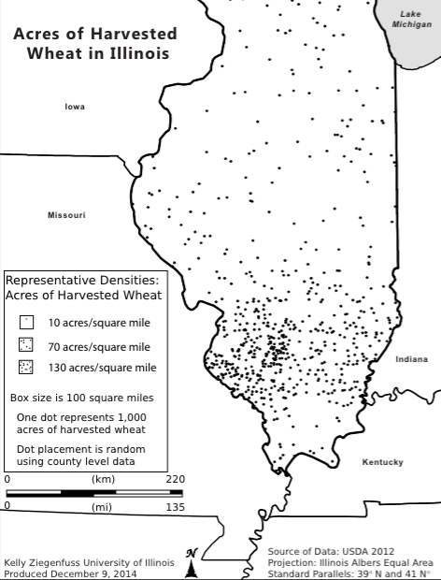
Notes:
Here we have representative density – or one to many dots of 1 dot represents 1000 acres of harvested wheat. Dot placement is random using county level data.

Slide 13
Proportional & Graduated Symbol Maps

Slide 14
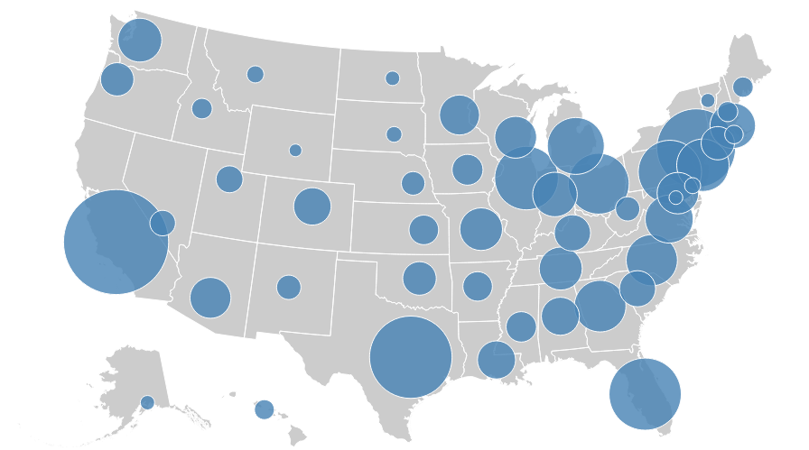
What: quantitative data, specific location or enumeration unit
Why: compare data at location or units
How: area, size
Challenges: occlusion, placement
Notes:
Stevenss data types, quantitative data, shcneiderman’s also

Slide 15
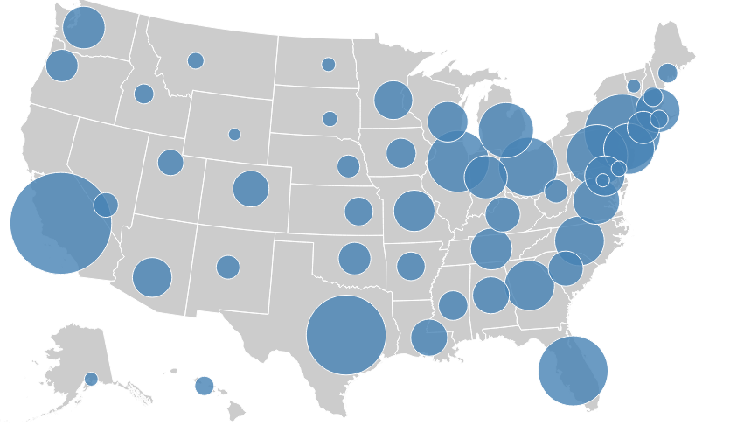
https://bl.ocks.org/mbostock/4342045
Notes:
State level but dot placed at largest city.

Slide 16

Image Source: https://blogs.scientificamerican.com
Notes:
Ebbinghaus Illusion two identical circles look different sizes depending on the size of the symbols around them.
https://blogs.scientificamerican.com/not-bad-science/an-optical-illusion-as-seen-by-a-fish/

Slide 17
Image Source: https://blogs.scientificamerican.com
Notes:
Ebbinghaus Illusion two identical circles look different sizes depending on the size of the symbols around them.
https://blogs.scientificamerican.com/not-bad-science/an-optical-illusion-as-seen-by-a-fish/

Slide 18
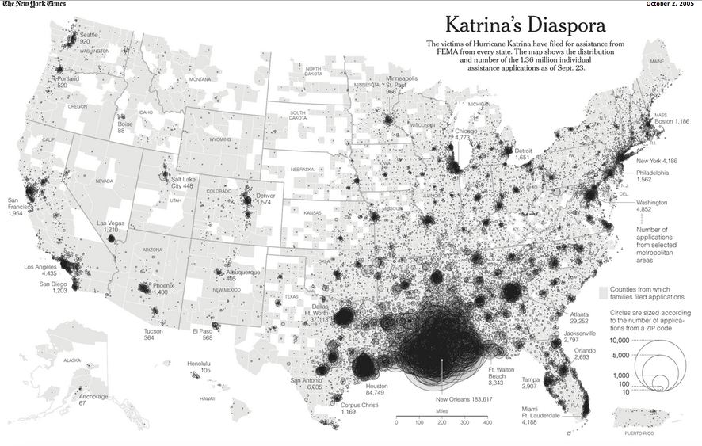
http://www.nytimes.com/imagepages/2005/10/02/national/nationalspecial/20051002diaspora_graphic.html
Notes:
Uses zipcode
Note open circle to handle occlusion

Slide 19
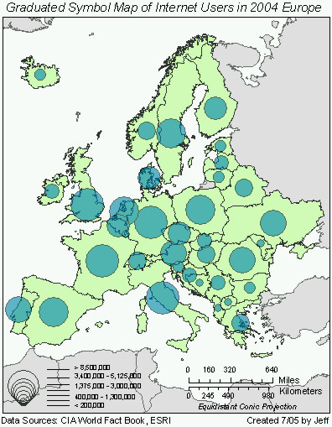
http://www.geog.ucsb.edu/~jeff/gis/proportional_symbols_files/map1.jpg

Slide 20
Isopleth Maps

Slide 21
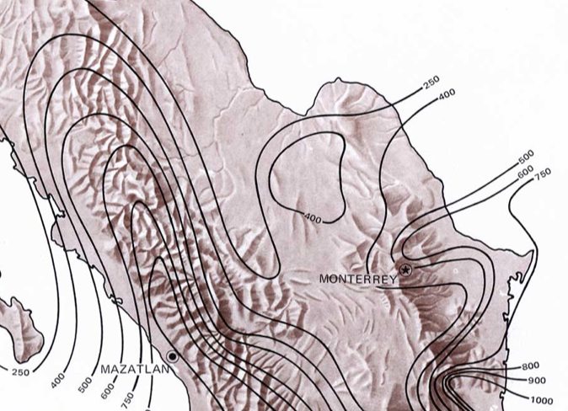
What: distribution data, location
Why: show & compare gradual change
How: isolines, color filled lines
Challenges: large amounts of data & smooth distribution are needed
Notes:
Isopleth maps use a series of lines called isopleths that connect points that are the same value. Isopleths don’t cross each other and form enclosed circular areas, though these may get cut off by the framing of the mapped region. Common data for ispleth maps that make sense using this third dimension are Elevation, temperature, rainfall

Slide 22
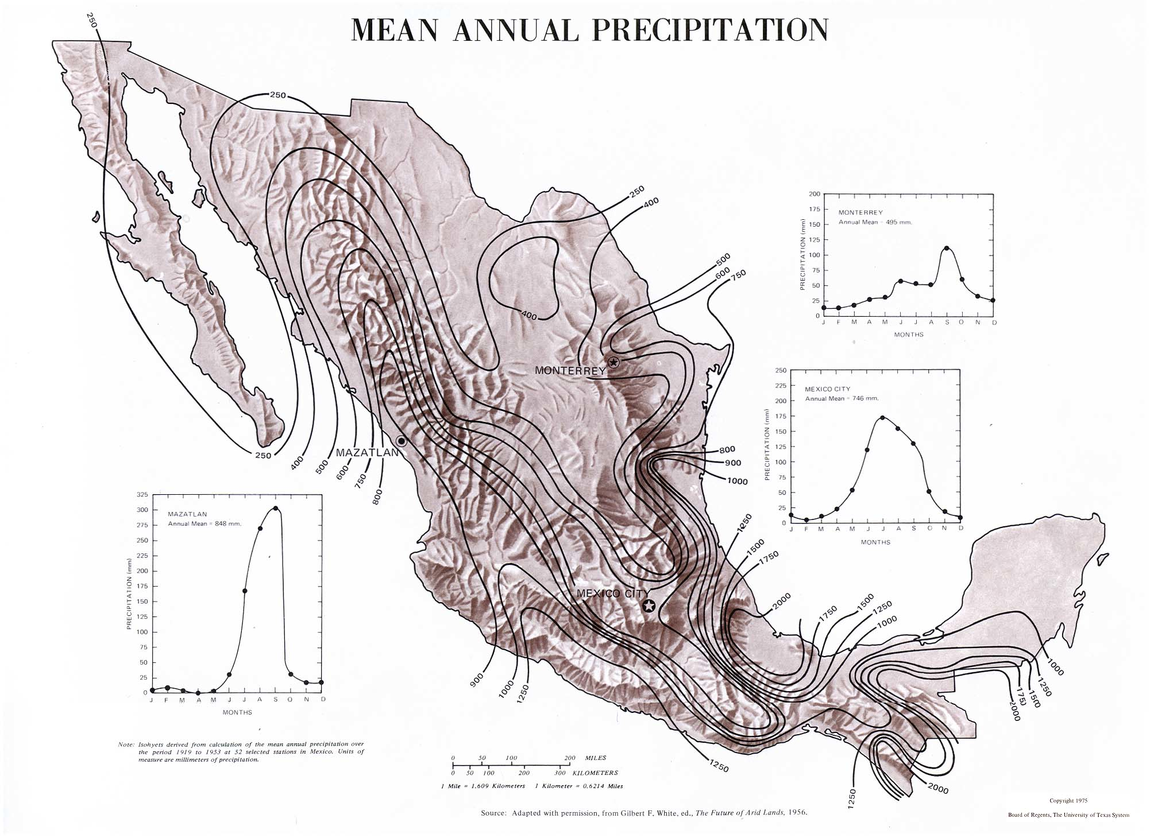
http://www.lib.utexas.edu/maps/atlas_mexico/mean_annual_precipitaion.jpg
Notes:
Values below the line are below and above the isoline above

Slide 23
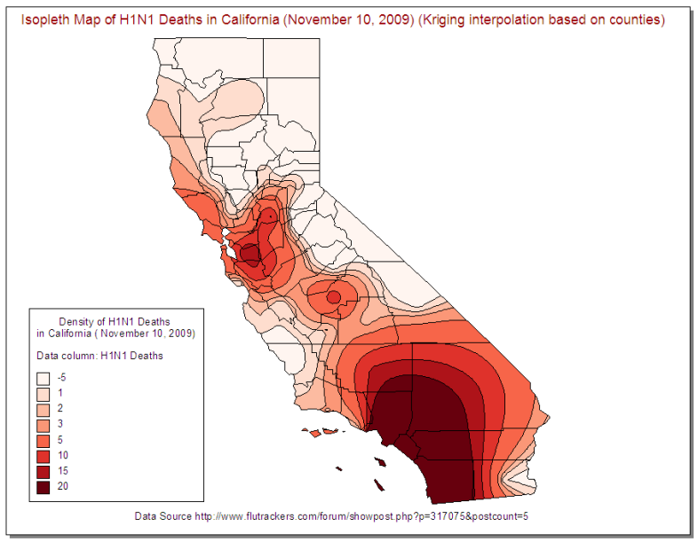
Source: https://flutrackers.com/
Notes:
Ranges of similar values are filled with a similar color or saturation

Slide 24
Flow Maps

Slide 25
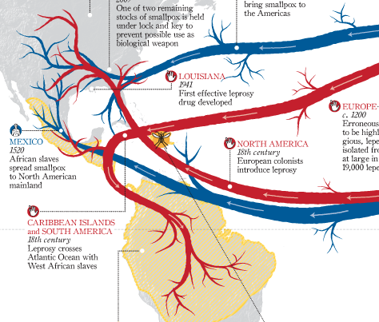
What: quantitative data, location, direction
Why: show locational movement
How: lines, area, size, color
Challenges: reduce clutter (merge edges, layer nodes, etc.)
Notes:
Stevenss data types, quantitative data, shcneiderman’s also

Slide 26
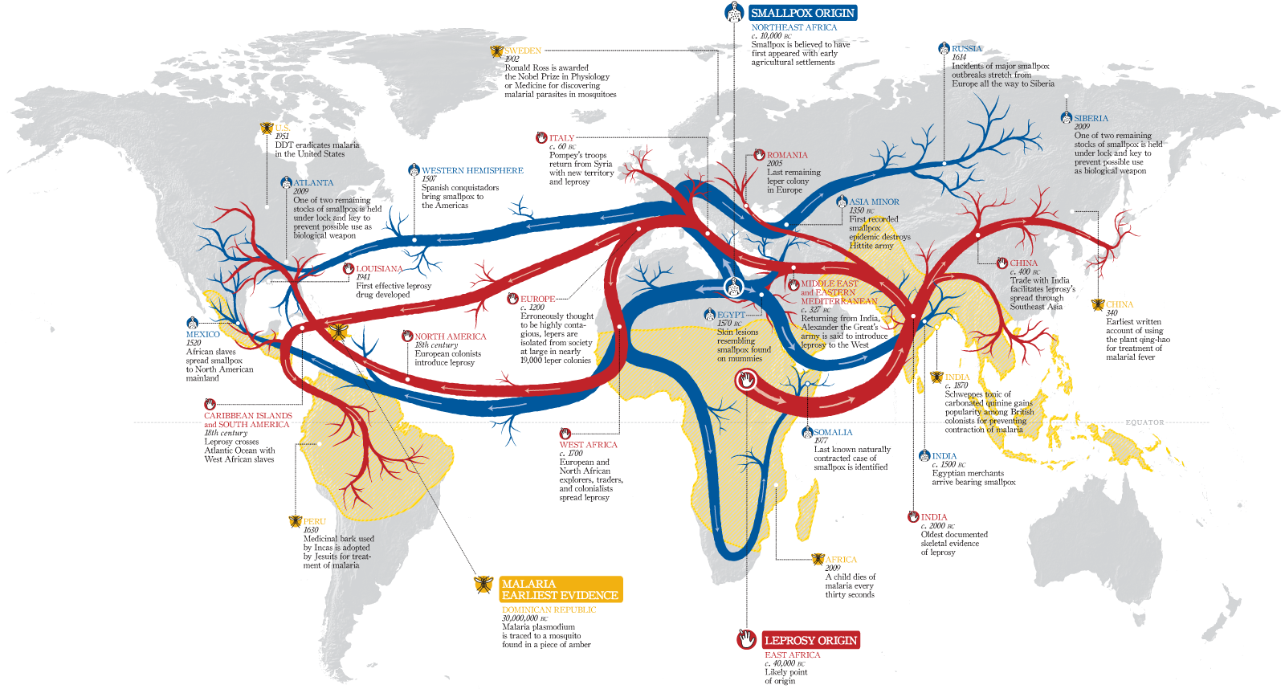
Source: https://www.laphamsquarterly.org/medicine/maps/contagion

Slide 27
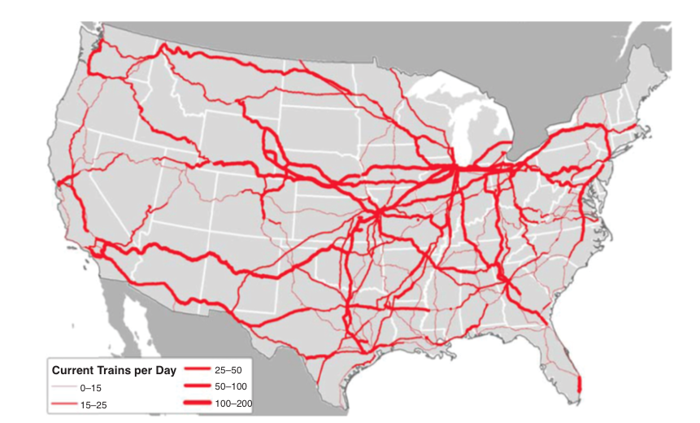
Source: Uddin & Hunyh, 2015. Freight traffic assignment methodology for large-scale road-rail intermodal networks.

Slide 28
Using Distortion

Slide 29
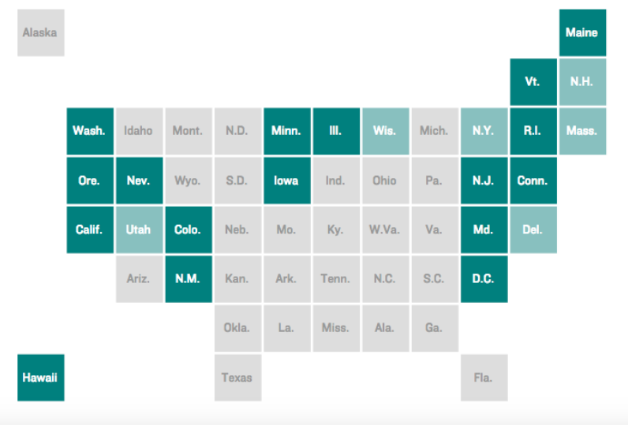
Tile Map
Source: http://blog.apps.npr.org/2015/05/11/hex-tile-maps.html
Notes:
Square tile map - Takes advantage of knowing the placement of states or geographic features. Deals with the ‘Alaska’ problem.
Some of the problems – such as north and south carolina are next to each other.

Slide 30
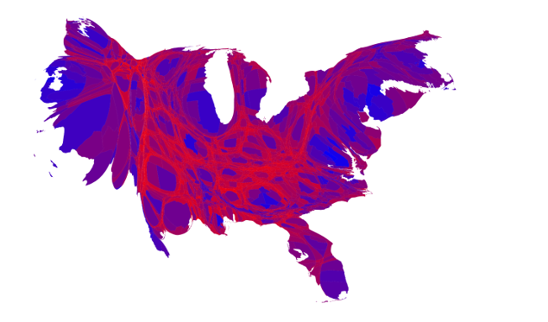
Cartograms
Source: http://www-personal.umich.edu/~mejn/election/2016/
Notes:
Cartograms contiguous (not connected states) and contiguous.

Slide 31
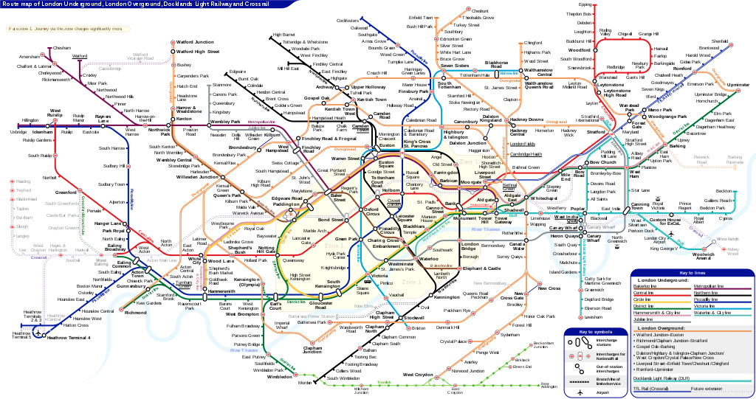
Topological Map
https://commons.wikimedia.org/wiki/File:London_Underground_Overground_DLR_Crossrail_map.svg#/media/
Notes:
London tube map first introduced in the 1930s showed this. Topological maps don’t have scale, distance, directioon, shows the relationship and connection between various points.

Slide 32
Considerations
What are the units or locations needed? (choropleths, proportional or graduated symbol maps, dot maps)
Is distribution or density important?
(isopleth maps, dot maps)
Is movement or change important?
(flow maps, small multiples)
Would distortion help or hinder perception? (cartograms, topological maps)

Slide 33


